Slide 1
VUTUBE
Watch all youtube videos without advertisments

Slide 2
Students involved --
KAUSTUBH DUBEY
BINAYAK SINGH
SAKSHAM GANGWAR
SHREYASH VARSHNEY
YOGESH KUMAR

Slide 3
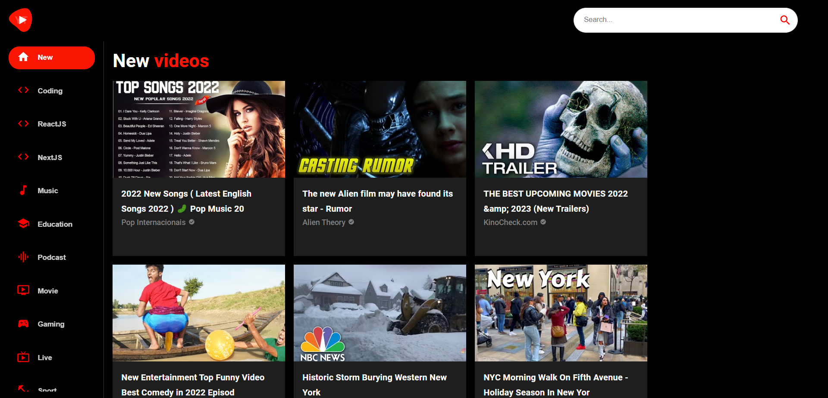
DEFAULT PAGE VIEW -

Slide 4
FUNCTIONALITIES-
Logo
Search Bar
Video feed
Categories

Slide 5
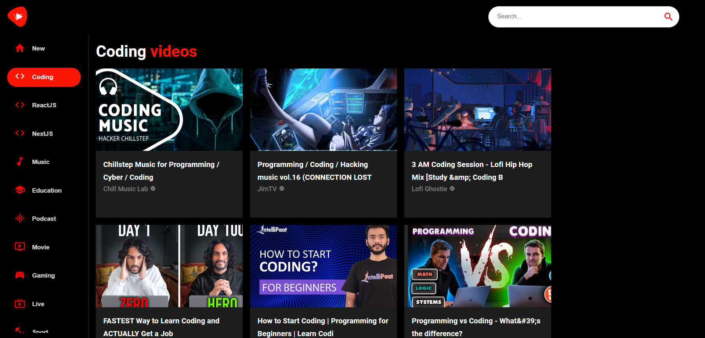
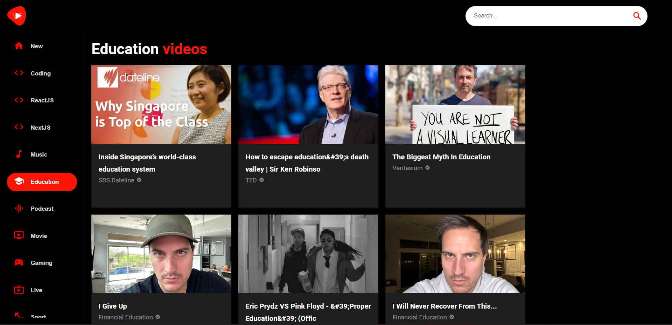
FUNCTIONALITIES-
Different category different videos based on category being selected……

Slide 6
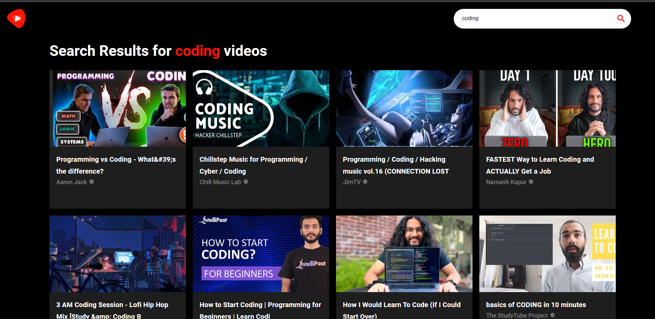
FUNCTIONALITIES-
Dynamic Search Bar that filters videos
According to the type of video user
Wants to search and watch on vutube…

Slide 7

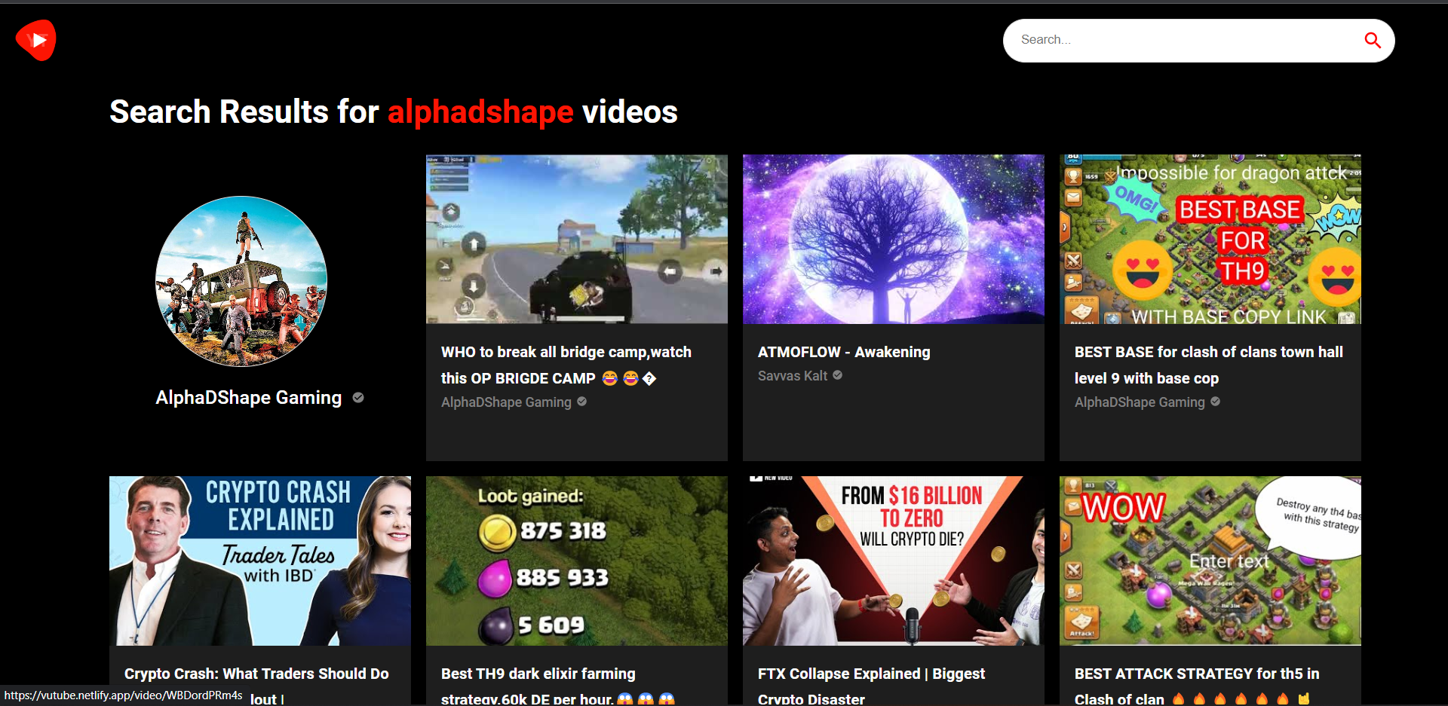
FUNCTIONALITIES-
Youtube Channels can also be searched and can be viewed on vutube…

Slide 8
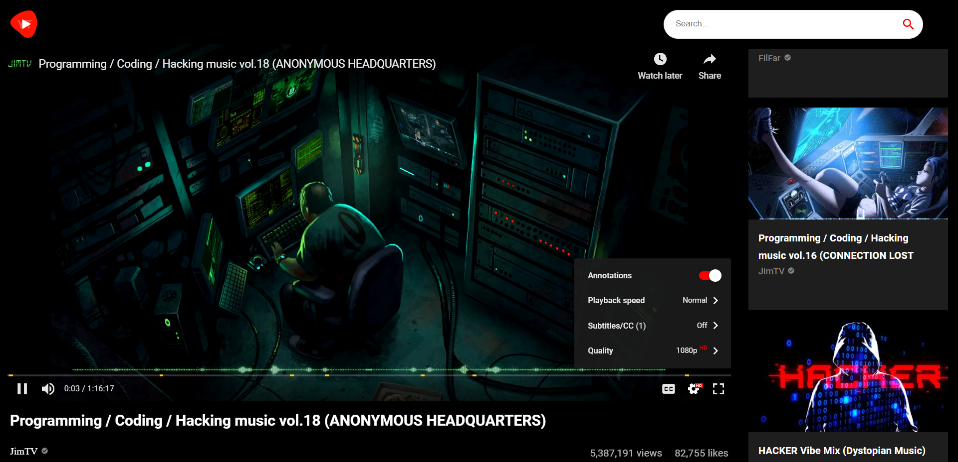
FUNCTIONALITIES-
Video Controls – quality,annotations,
subtitle,playback speed…

Slide 9
FUNCTIONALITIES-
Video Suggestion based on type of video Being watched….

Slide 10
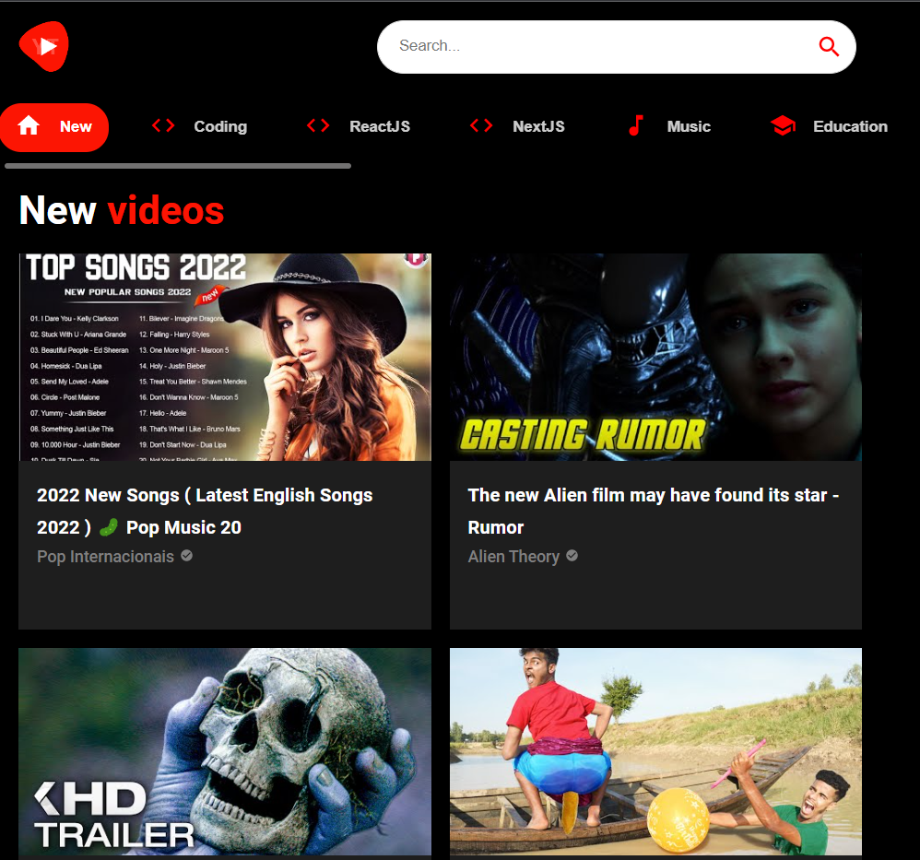
FUNCTIONALITIES & RESPONSIVENESS
VUTUBE FOR SMALL SIZE LAPTOP SCREENS AND RESPONSIVENESS

Slide 11
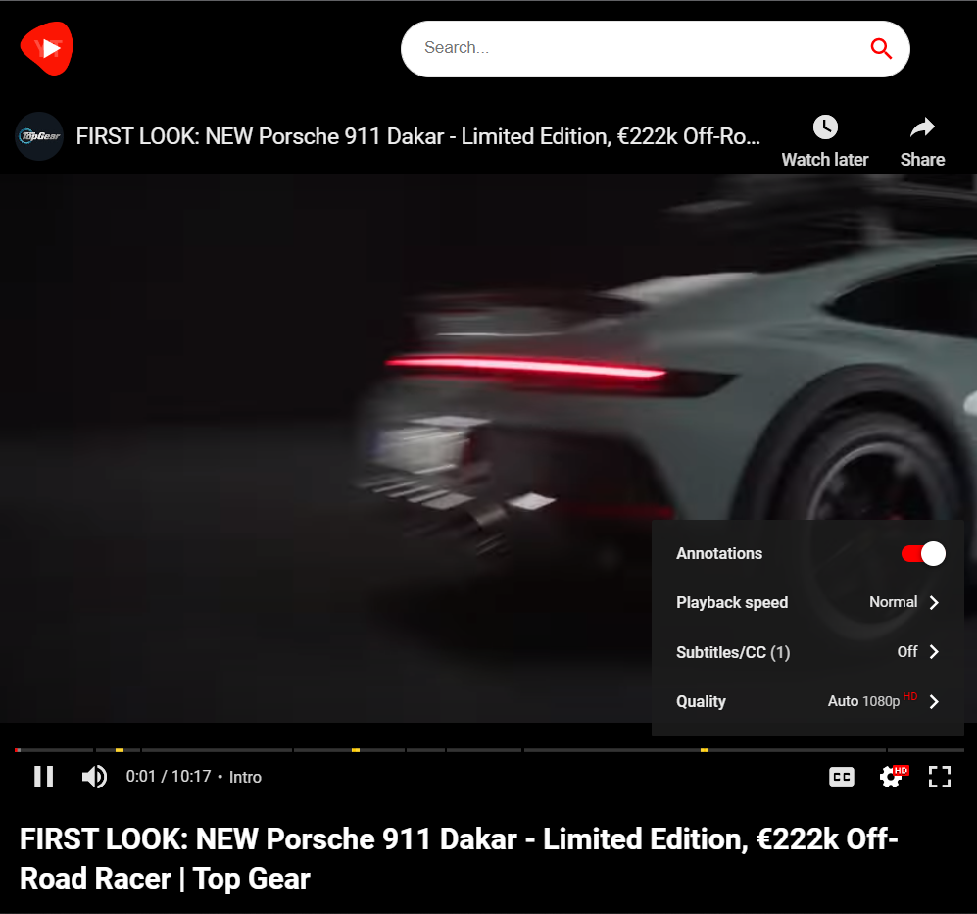
FUNCTIONALITIES & RESPONSIVENESS
VIDEO VIEWING IN SMALL SCREEN WITH VIDEO CONTROLS…..

Slide 12
THANK YOU
PLEASE VISIT AGAIN AND WATCH VIDEOS ON VUTUBE……..

